Slide 1
Introspection and emergence of psychology as a science

Slide 2
Starter
As you walk in to the room you have been given a key term from one of the approaches that you looked at yesterday.
Individually, decide which approach the key term belongs to and go and stand next to the whiteboard.
Jot down as much information as you can remember about the approach on your whiteboard

Slide 3
That is your group for today
On your table are some of the key assumptions of the approaches that you were introduced to yesterday.
As a group decide which approach the assumptions belong to.

Slide 4
Objectives
To outline and evaluate the process of introspection, as a method for examining the human mind.
To understand the development of psychology as a science, by recreating a timeline for the history of psychology.

Slide 5
Wilhelm Wundt
William was the first person to be called a psychologist.
He opened a psychology laboratory in Germany in 1879
He wanted to explore the human ‘mind’…
His approach to psychology was to study the structure of the human mind, by breaking down behaviours into their basic elements, hence his approach became known as structuralism.

Slide 6
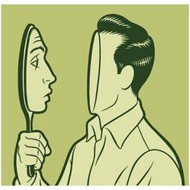
What is introspection?
Wundt was interested in conscious experience
Introspection means “looking into”
It is the examination of ones thoughts.
Subjects would be presented with a problem to solve or something to memorise. They would be asked to report back their inner experiences.
Introspection was obtained during task performance rather than after to avoid memory problems.

Slide 7
How did this experimental process work?
Highly trained observers were presented with carefully controlled sensory events.
Describe their mental experiences of these events.
The observations were repeated numerous times.

Slide 8
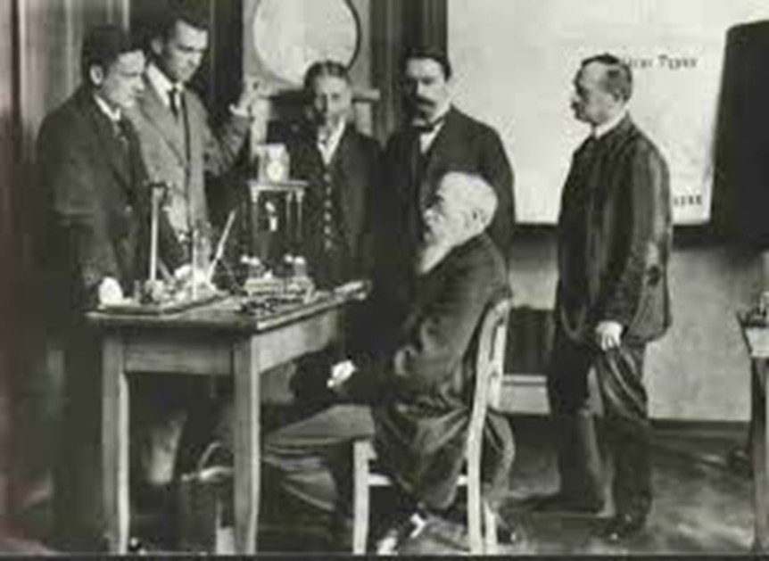
Introspection – Have a go!
You have been given a Sudoku puzzle to complete. You have 2 minutes to complete the puzzle
You must use introspection to feedback your cognitive processes which will be recorded on your phone
What are the limitations of this method?
Challenge – Despite its limitations, why do you think this signified the start of Psychology as a science?
Notes:
https://www.youtube.com/watch?v=D9c364BrOio

Slide 9
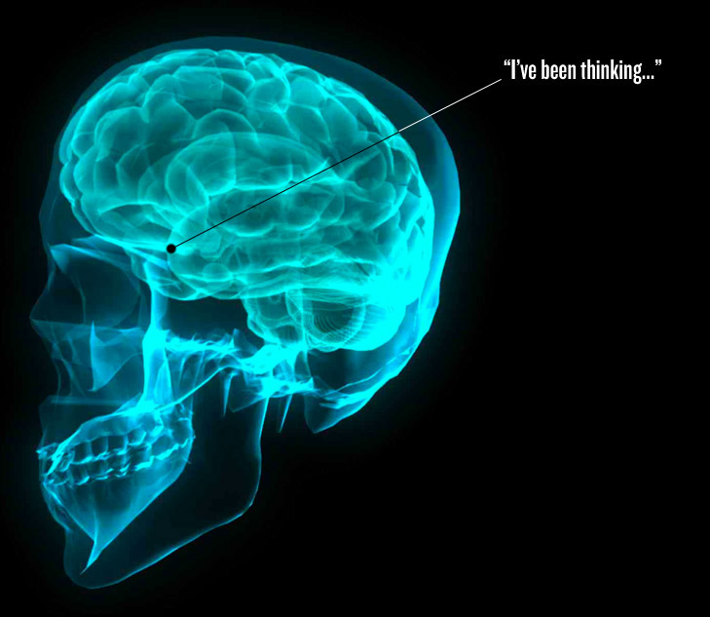
Introspection
Introspection relies primarily on non-observable responses and although participants can report conscious experiences, they are unable to comment on unconscious factors relating to their behaviour.
Introspection produced data that was subjective (varied greatly from person to person), so it became very difficult to establish general principles. This means that introspective experimental results are not reliably reproduced by other researchers.

Slide 10
However, at the time…
Wundt strictly controlled the environments where introspection took place, controlled the stimuli and tasks that participants were asked to think about, limited the range of responses they might give and trained his participants so that they could give the most detailed observations possible.

Slide 11
Furthermore….
Introspection has not been entirely abandoned.
For example, Griffiths (1994) used introspection to study the cognitive processes of fruit machine gamblers.
He asked them to ‘think aloud’ whilst playing a fruit machine into a microphone on their lapel.
Wundt’s work also paved the way for later controlled research and the study of mental processes e.g. by cognitive psychologists
Therefore the concept still has some useful application to Psychology today.

Slide 12
Activity
Complete the worksheet to consolidate your learning on Introspection

Slide 13
Exam Practice
Core
Individually have a go at one of the following
Outline one criticism of introspection as a method of investigation (3 marks).
Explain Wundt’s contribution to the development of Psychology (4 Marks)
Explain what is meant by the term introspection (4 marks)
Extension
Challenge- Explain the emergence of Psychology as a science (6 marks

Slide 14
Explain Wundt’s contribution to the development of Psychology (4 Marks)
Possible content:
Wundt known as ‘the father of psychology’ – moved from philosophical roots to controlled research
Set up the first psychology laboratory in Liepzig, Germany in 1870s
Promoted the use of introspection as a way of studying mental processes
Introspection – systematic analysis of own conscious experience of a stimulus
An experience was analysed in terms of its components parts eg sensations, emotional reaction etc.
His work paved the way for later controlled research and the study of mental processes eg by cognitive psychologists.

Slide 15
Outline one criticism of introspection as a method of investigation (3 marks).
One criticism of Introspection is that it is too subjective. Introspection is not a scientific or valid way of measuring behaviour. Participant observations were subject to bias as they relied on participants revealing their own private subjective experience meaning that the procedure could not be replicated.

Slide 16
Explain/ Discuss the emergence of Psychology as a science( 8 marks)
Outline content
Wundt- Psychology as a separate discipline
Wundt showed that empirical methods could be applied to the study of mental processes.
Introspection
Empirical methods of research are based on actual experience rather than on theory or belief.
Emergence of Behaviourism due to subjectivity of introspection
The laboratory experiment
Objectivity
Discussion - Should psychology be a science? Two of the following
Much of the subject of Psychology is unobservable therefore a scientific approach is not appropriate
Determinism- Adopting a scientific approach suggests behaviour has a cause and is therefore determined. This helps psychologists predict behaviour which has useful application especially in managing and treating abnormality
Objectivity reduces reality- Objective methods of science often involve artificial tasks and removing the individual from their natural environment which can

Slide 17
Emergence of psychology as a science
https://www.youtube.com/watch?v=Zohkzd0MYiI
Note down the features of science and key terms mentioned in the clip

Slide 18
Psychology as a Science
Different psychological approaches emerged at different times and in your induction you encountered four approaches to psychology.
Task: In groups, put the approaches in the correct order in which they emerged, telling the story of how psychology emerged as a science. Also try to match the ‘date’ which goes with each approach.
You have 10 minutes.
10 Minutes

Slide 19
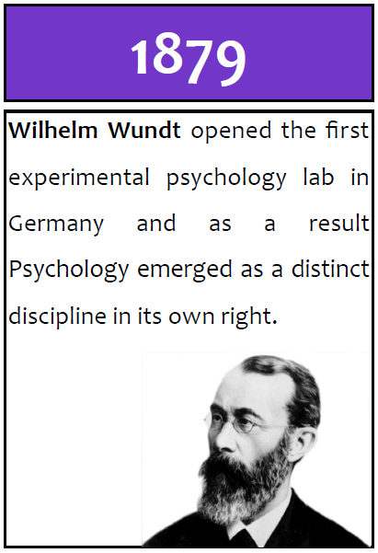
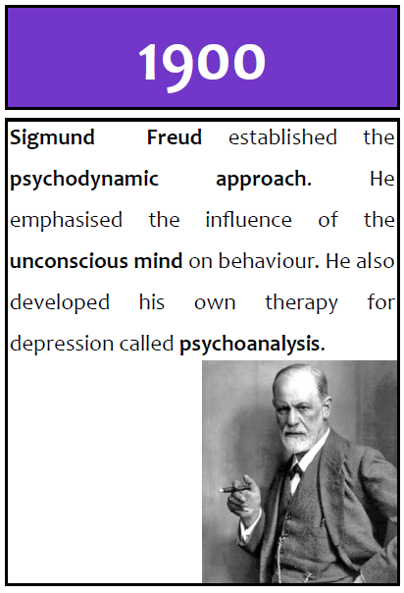

Slide 20
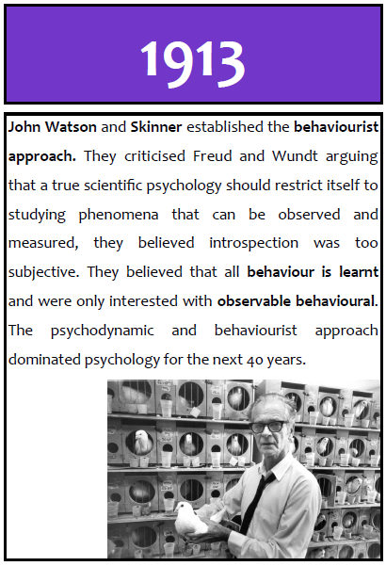
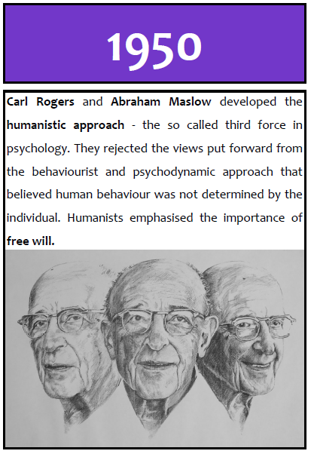

Slide 21
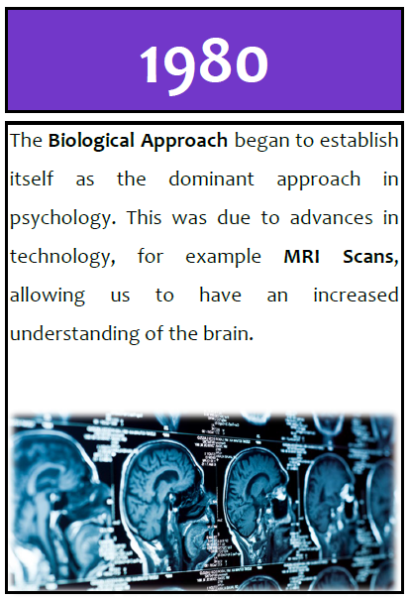

Slide 22
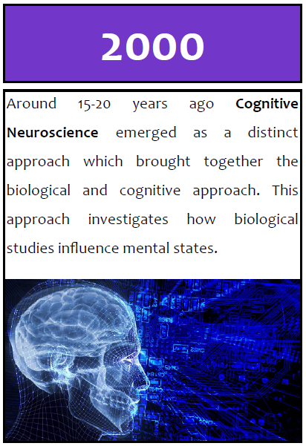

Slide 23
Debate
Should Psychology be a science?

